Slide 1

Book Recommendation
95729 - Fall 2021
E-Commerce Tech Final Presentation
Ruoqi (Rebecca) Li ruoqili@andrew.cmu.edu
Lan (Evelyn) Wei lanwei@andrew.cmu.edu
Peixin Zhao peixinz2@andrew.cmu.edu

Slide 2

Agenda
User story
Model
User-based
Item-based
Comparison
Web design & Demo
Limitations
Future Improvement

Slide 3
User Story
Who
Adult users who want to explore more books catering to their tastes
Solution: Ask users to rate 10 random books and recommend 10 new books to them on a web end
What
An app that can recommend new books based on books users have read
Why
Because users sometimes find it hard
to handpick the right book!

Slide 4



Data Needed
Target User’s rating of books
Book ratings of 3,652 users
User-based
Solution
Recommendation based on the similarity of users
Find 20 users that are mostly similar to the target user
Assign scores to books rated by them
Weighted rating * similarity scores
Rank by score to get the top 10 books
Assumption:
Users who gave out similar ratings to certain books will be likely to share similar tastes in books.
Advantage
Give users freedom to explore a wide range of books that they might like

Slide 5
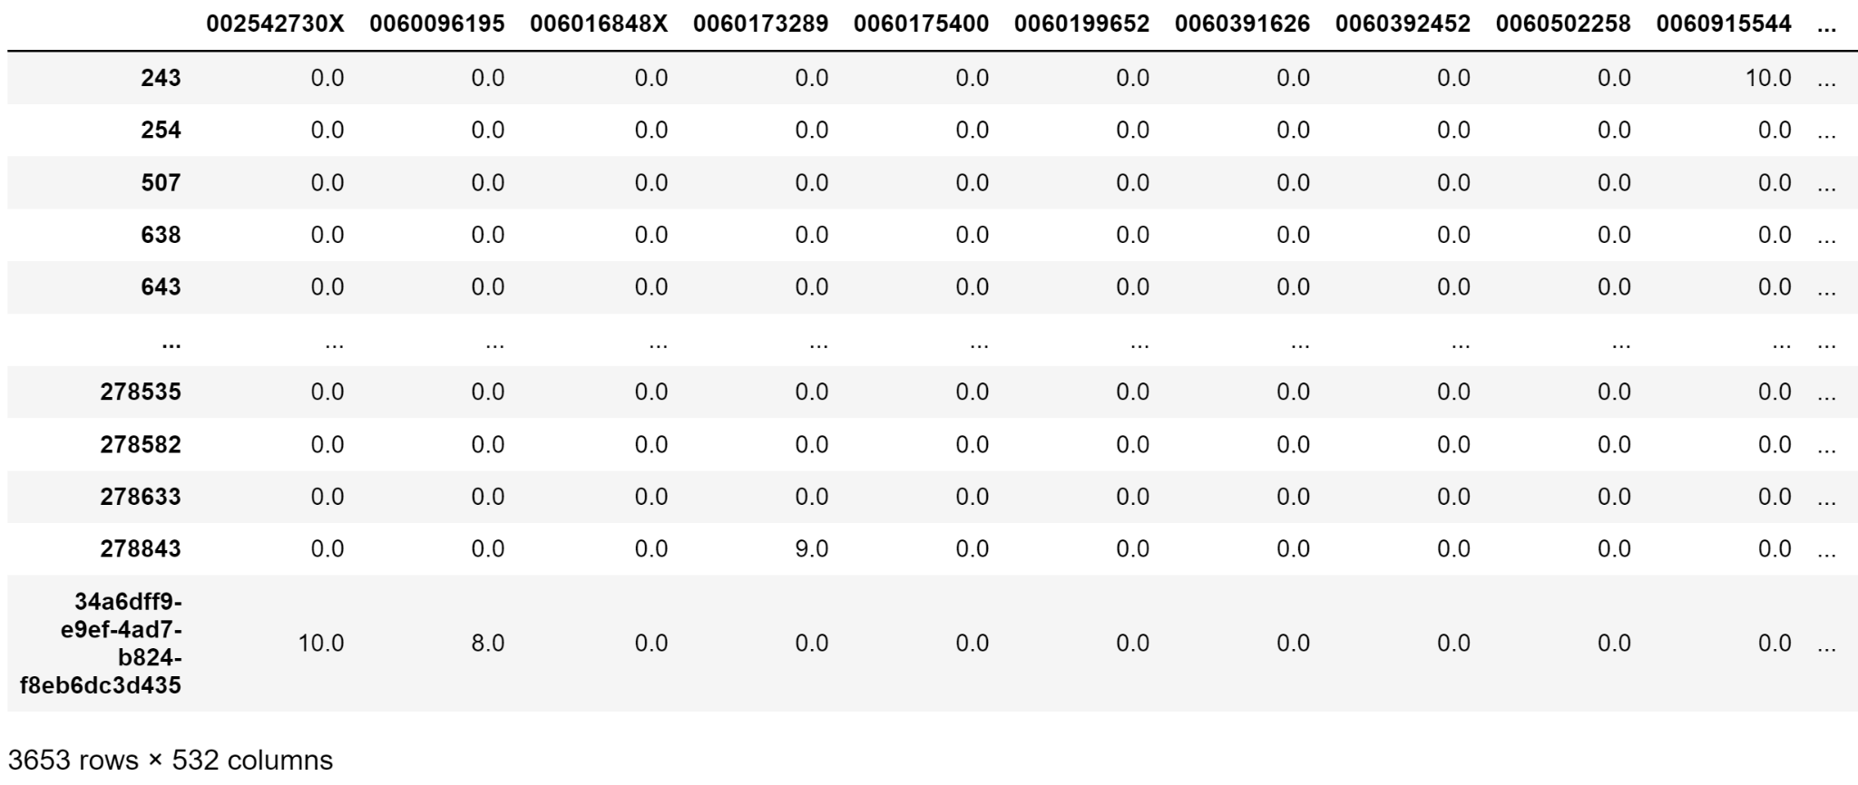
MODEL
LIST OF BOOKS
B1, B2, ...
LIST OF USERS
U1, U2, ...
B1
B2
B3…..
User-Book Rating Matrix
U1
U2
U3
...
New User input ratings

Slide 6
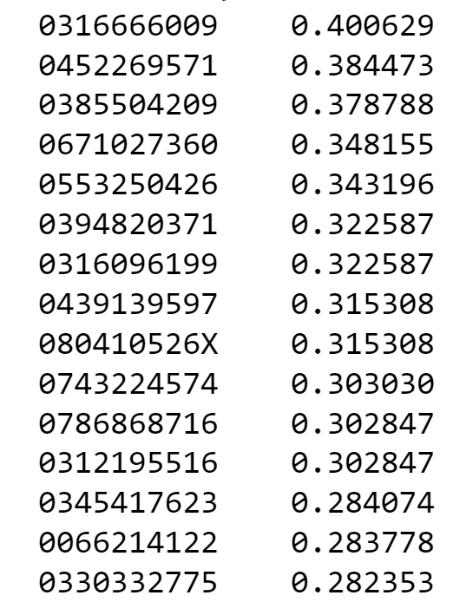
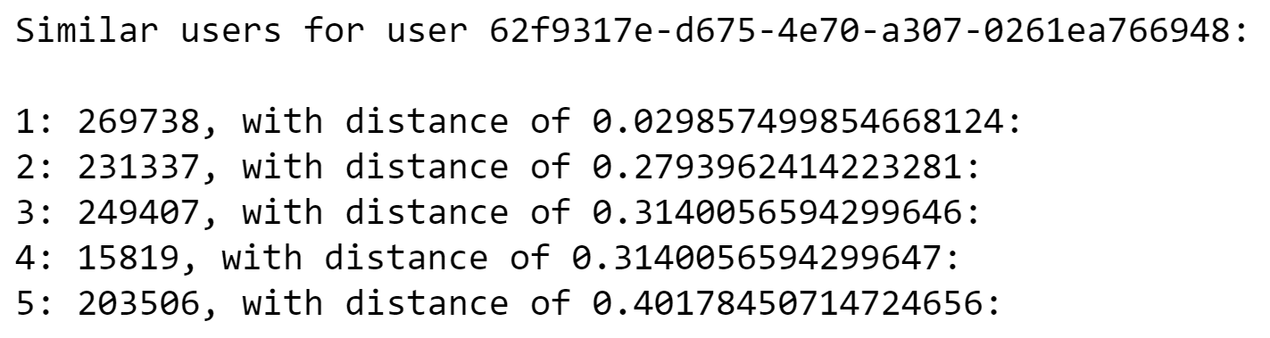
MODEL
ISBN
Final Score
LIST OF BOOKS
B1, B2, ...
LIST OF USERS
U1, U2, ...
K-Nearest Neighbors
Similarity = 1 - distance
Rating is adjusted (R<5 will have a negative score)
Final score = sim * adjusted rating
<Only 5 neighbors are shown here>
Books with top 10 final score will be recommended

Slide 7


Slide 8
Data Needed
Target User’s rating of books
The tags and author of books
Item-based
Solution
Recommendation based on the similarity of books
Create text feature that combine tags and author name of each book
Use text similarity and rating as score
Rank by score to get the top K results
Assumption:
Users tend to enjoy books with similar topics and genres or from the same authors.
Advantage
Recommend books that best fit the target users’ interests

Slide 9
MODEL
USER A
LIST OF BOOKS
B1, B2, ... , B10
LIST OF RATINGS
R1, R2, ... , R10
FOR EACH BOOK:
TF_IDF + cosine similarity
Tags + Author Name
Tags + Author Name
Similarity
Score
B1
John Grisham fiction english books mystery adult-fiction literature audible ebooks historical general american favorite-authors usa life paperback boys historical-fiction literary-fiction southern southern-fiction drama fiction-general
X1
Stephen King fantasy fiction sci-fi-fantasy supernatural mystery contemporary contemporary-fiction thriller science-fiction scifi adult adult-fiction thrillers fiction-horror scary horror-thriller maine king stephen-king king-stephen thriller-horror human-alien
0.85
0.68
-0.17
R1
8
3
X2
Michael Chabon american 21st-century never-finished couldn-t-finish 2000s pulitzer-prize pulitzer-prize-winners literary-fiction world-war-ii holocaust comic lgbt lgbtq queer superheroes
0.78
0.624
-0.156
Score = sim*weight
...
...
...
R>5: weight = R/10
R<=5: weight = (R-5)/10
Xn
Nicholas Sparks love contemporary-fiction realistic general-fiction historical-fiction on-my-bookshelf drama high-school relationships reviewed romantic stand-alone love-story
0.008
-0.0016
0.0064

Slide 10
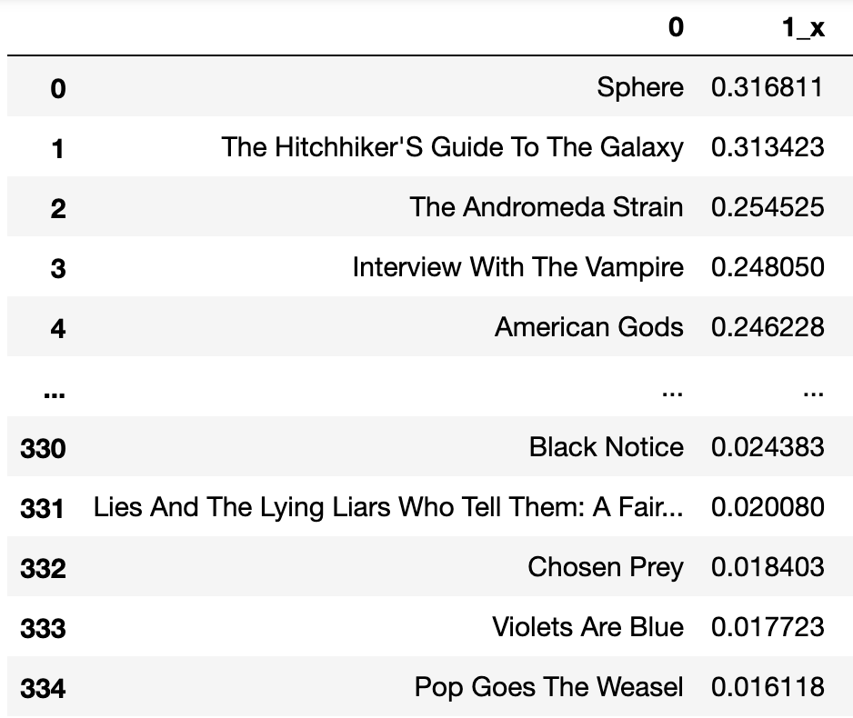
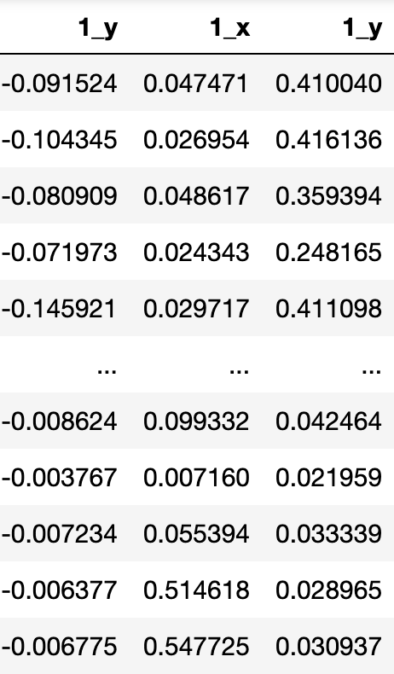
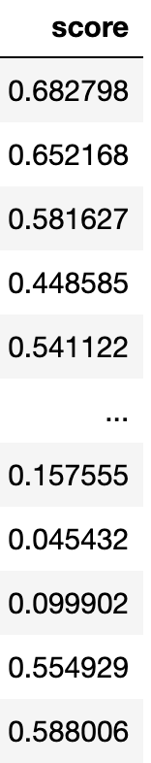
MODEL
USER A
LIST OF BOOKS
B1, B2, ... , B10
LIST OF RATINGS
R1, R2, ... , R10
B1
B2
B3…..
B10
SUM
Order by SUM desc
TOP 10 Books

Slide 11
Comparison
User-based VS Item-based
User-based
Item-based
Bastard Out of California, The Book Of Ruth, Into Thin Air : A Personal Account Of The Mt. Everest Disaster, Pretend You Don'T See Her, Prey, 1St To Die: A Novel, American Gods, The Andromeda Strain, The Summerhouse, Notes From A Small Island
Jurassic Park, The Lost World, The Andromeda Strain, Congo, Timeline, The Notebook, American Gods, A Time To Kill, Message In A Bottle, Prey
Might not best capture the user’s preferences (limited by the cold-start scenario)
Good for exploration
Clustered in similar range of books from same authors
Limited Types of Books (Exploit within the current interests)

Slide 12
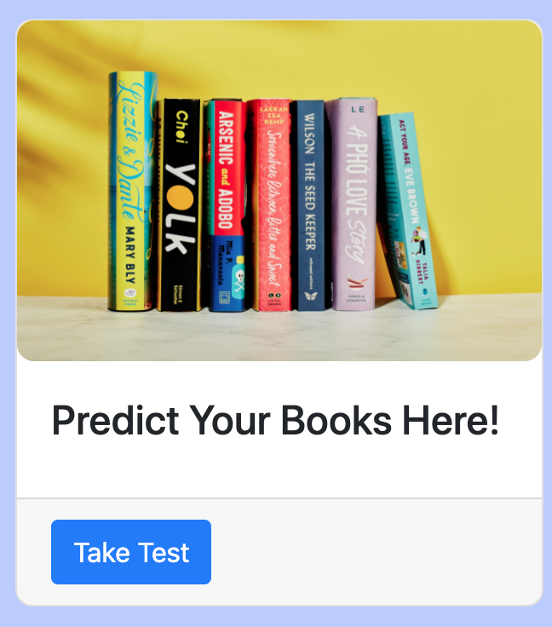
Web Design

Slide 13
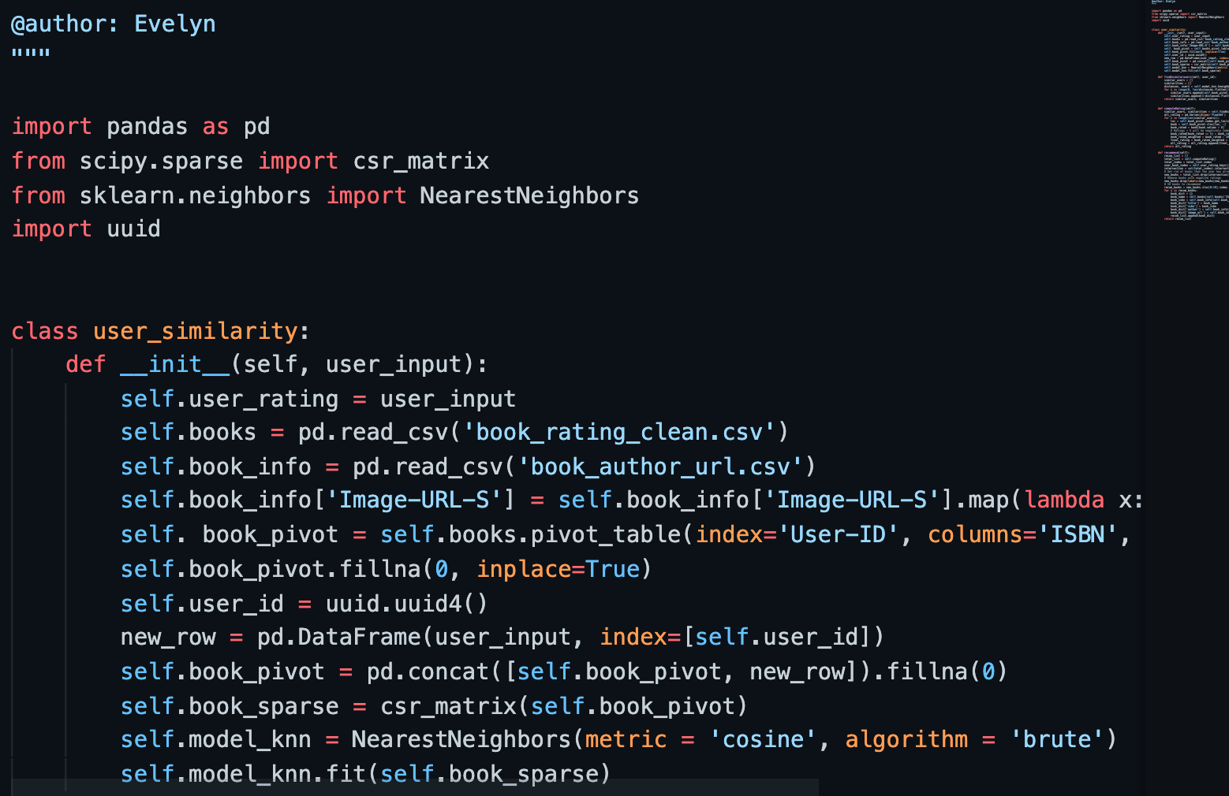
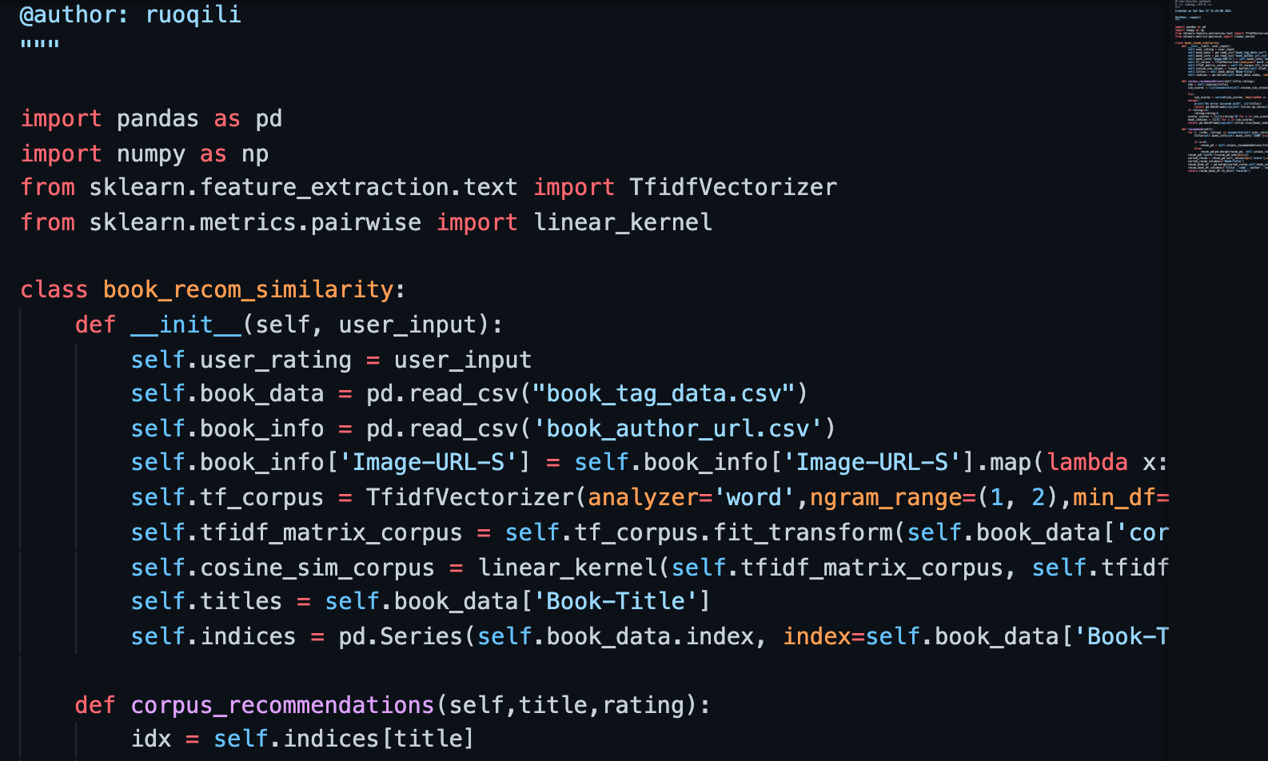
The Single Responsibility Principle
A class only have one responsibility and have only one reason to change.

Slide 14
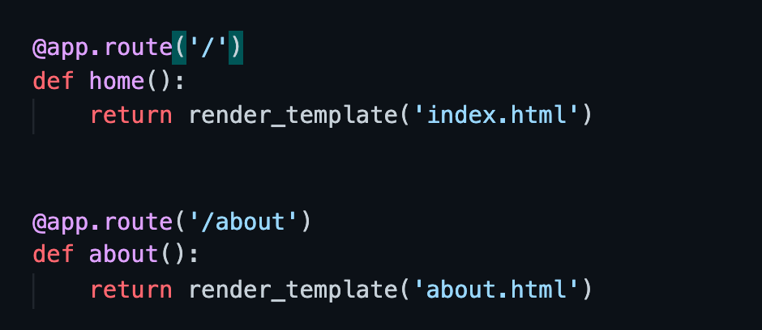
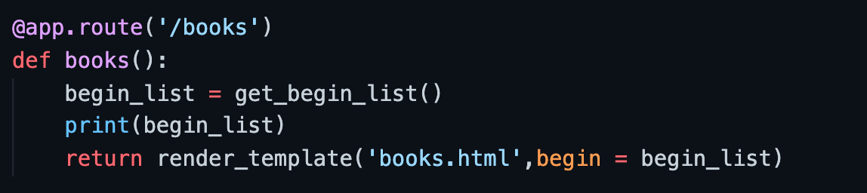
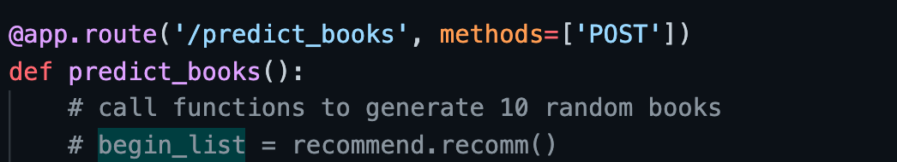
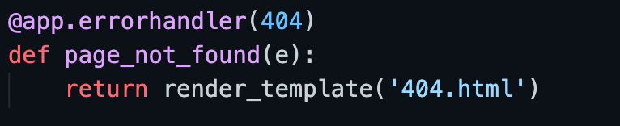
The Interface Segregation Principle
A caller need only implement the interfaces it needs to perform a unit of work (UOW). Given the right modality, following ISP should also reduce the impacts of change.

Slide 15

Web Demo

Slide 16


Limitations
Some limitations of our current design
User Input in cold-start
scenario
Type of books
User Effort
Most of the books are novels
10 ratings might be too much to ask
User experience
Not enough information
Too intuitive
Rating bias

Slide 17

1. Dataset
A more complete dataset of various genres and types of books through scrapping
Future Efforts
2. Model
Try out more advanced models that integrate more information
Ensemble models
Based on our current limitations and challenges, there are some future directions for improvement.
3. Better UI Design
Make the onboarding rating process more fun and easier for users. (e.g. more interactions and special effects)
…

Slide 18
Thank You!

